Slide 1
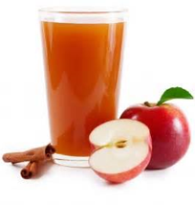
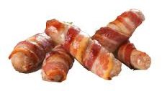
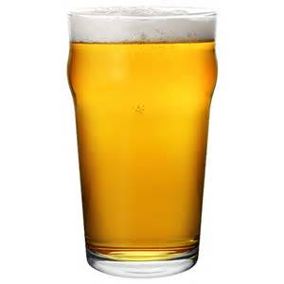
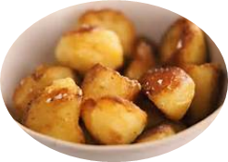
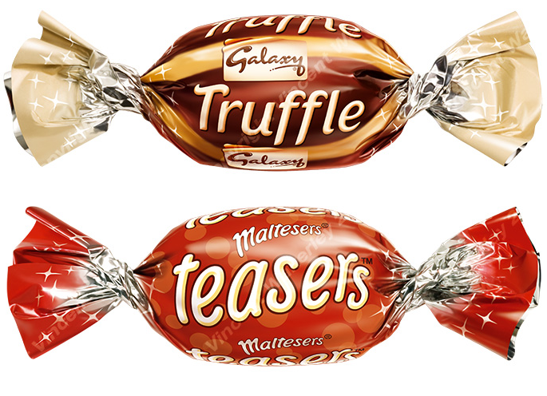
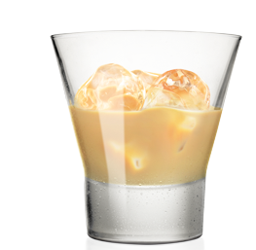
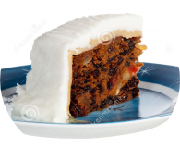
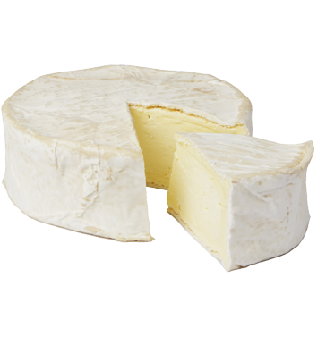
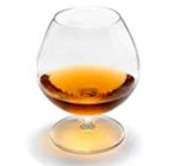
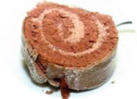
Festive Calorie Alcohol Equivalents
1 Small Glass of Prosecco
2 x Festive Chocolates
1 Pint of Hot Fruit Cider
5 Pigs in Blankets
1 Pint of Lager
1 Portion of Roast Potatoes
90kcal
295kcal
275kcal
227kcal
240kcal
250ml Glass of Red Wine
1 Large Baileys
1 Slice of Christmas Cake
1 Large Brandy
1 Slice of Chocolate Yule Log
1 Slice of Brie (60g)
312kcal
180kcal
210kcal
191kcal
327kcal
157kcal
www.Mac-NutritionMentoringLab.com

